Slide 1
Unit 3 modern architecture
By tanlanfang

Slide 2
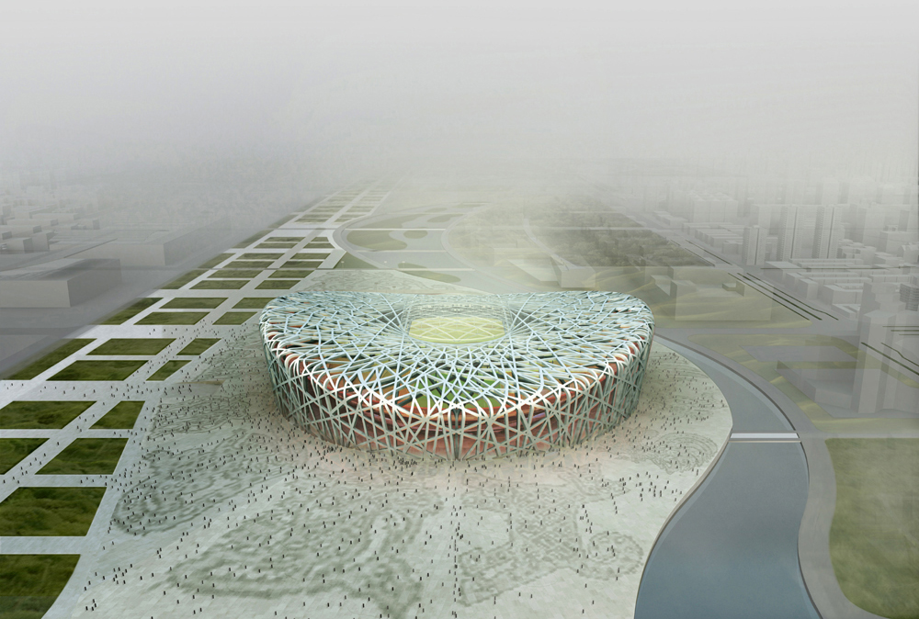
the 2008 Olympic Stadium in Beijing

Slide 3
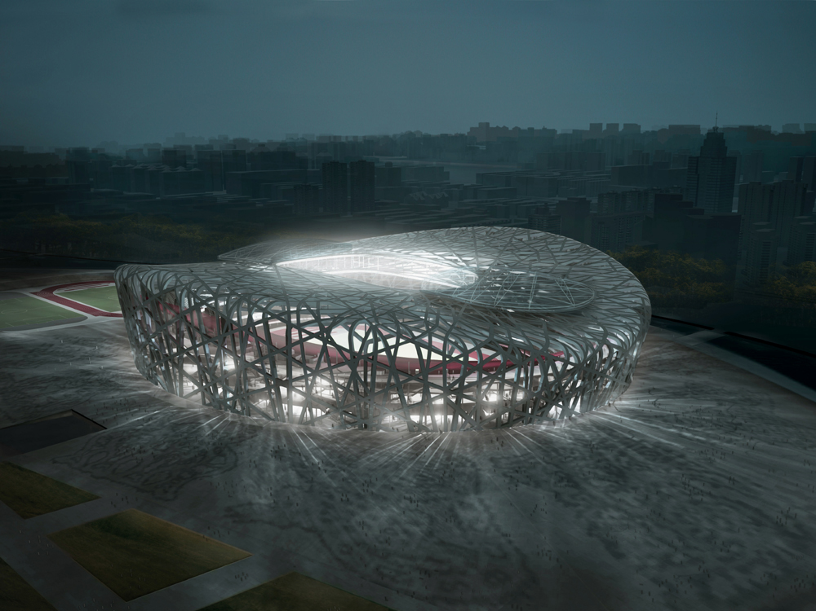
It looks like a bird’s nest .

Slide 4
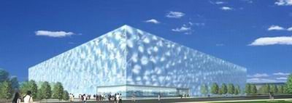
the National Swimming Center in Beijing

Slide 5
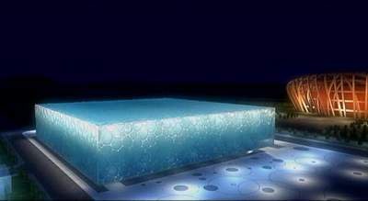
It looks like a piece of huge ice.

Slide 6
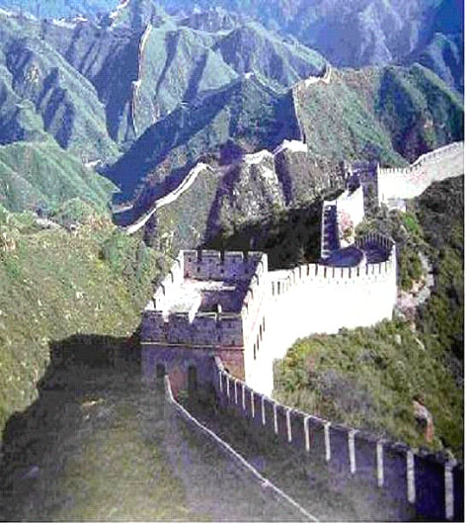
the Great Wall
It looks like a dragon over mountains.

Slide 7
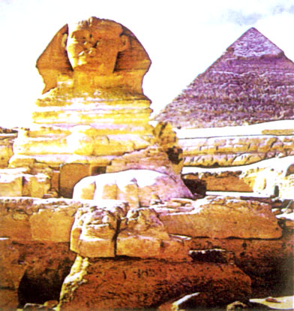
the Sphinx and Pyramids
grand
ancient
mysterious

Slide 8
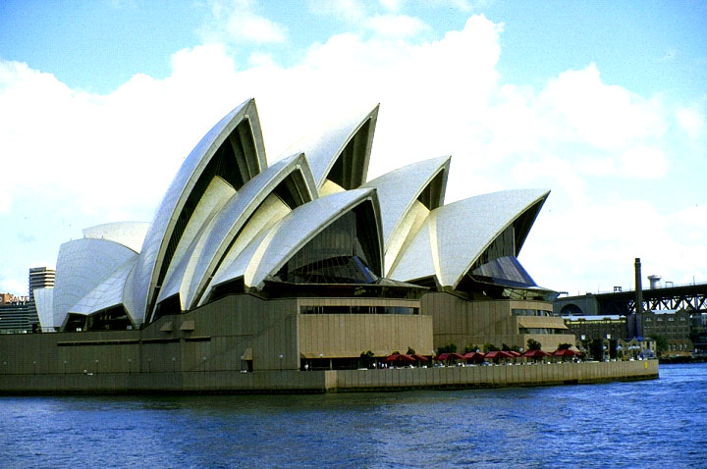
the Opera House
It looks like seashells.

Slide 9
Look at the pictures and the title of the text, what do you think the text is about:
The text is about classic Chinese architecture.
Some modern architecture takes examples from nature.
The text is about parks and gardens.

Slide 10
Tell the differences between modern and classical architecture
 | Modern architecture | Classical architecture
Materials | Steel, iron, glass… | Stone,brick,wood…
Characteristics | Huge; like boxes; unfriendly | Beautiful, closer to nature

Slide 11
Modern architecture
Architects
Examples
Characteristics
time
materials

Slide 12
Homework: finish the word study

